Slide 1
Welcome to the Web Application Development with Python L-4 Training Program

Slide 2
MD. SHAKIL
NSDA Certified Trainer & Assessor
Vendor Certified
IT Specialist in Python
Sr. Backend Developer
Ethical Den
Asst. Trainer
Daffodil International Professional Training Institute
Lead Trainer
eShikhon IT Training Institute
Lead Trainer
Wizard Software & Technology
+88 01793-299882
shakil.eub.cse@gmail.com
https://www.linkedin.com/in/mrshakil015
https://mrshakil.com

Slide 3
Function in Python
Lecture
10

Slide 4
What is Function?
A function is a reusable block of code that performs a specific task. Functions help in reducing code duplication and improving code organization.
A function is a block of code which only runs when it is called.
You can pass data, known as parameters, into a function.
A function can return data as a result

Slide 5
Why used Functions?
Avoid code repetition
Improve readability
Make debugging easier
Reuse logic multiple times
Organize large programs

Slide 6
Types of Function
Built-in functions (e.g., print(), len(), type())
User-defined functions (functions you define yourself)

Slide 7
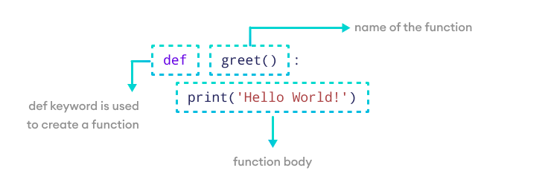
Create a Function
In Python a function is defined using the def keyword:

Slide 8
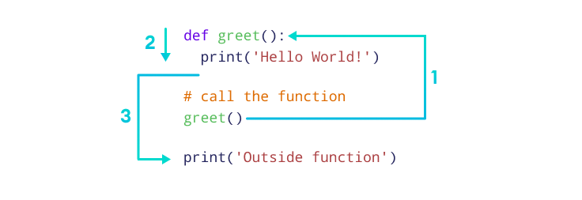
Calling a Function
To call a function, use the function name followed by parenthesis:

Slide 9
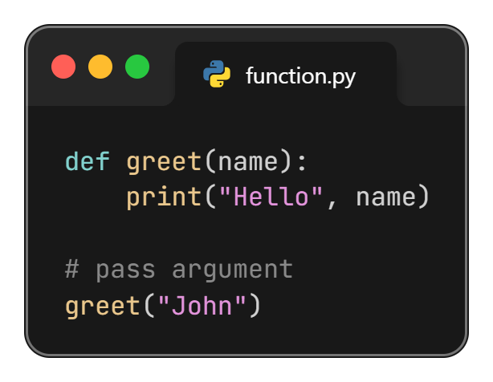
Python Function Parameters
A parameter is the variable listed inside the parentheses in the function definition.
Parameter

Slide 10
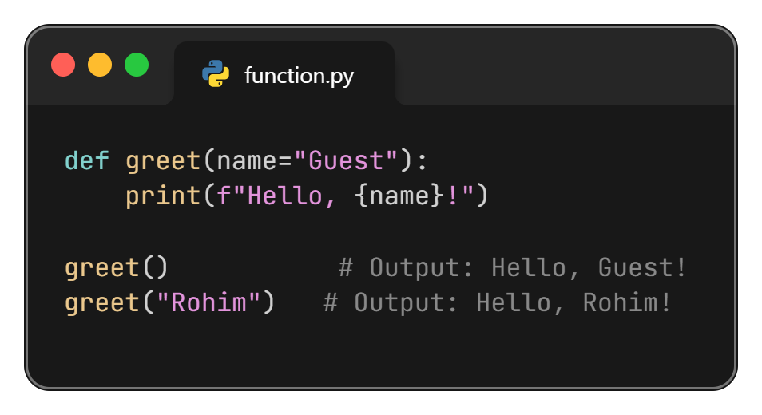
Function with Default Parameters
Default parameter values are used if no argument is provided.

Slide 11
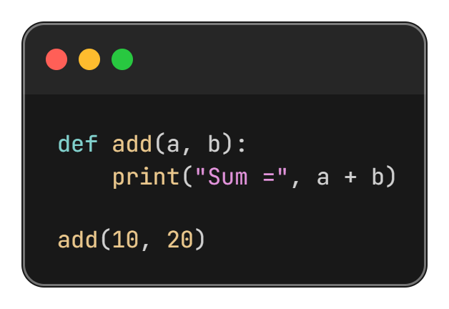
Function with Multiple Parameters

Slide 12
Python Function Argument
In computer programming, an argument is a value that is accepted by a function.
Arguments are inputs given to the function.
Arguments are specified after the function name, inside the parentheses. You can add as many arguments as you want, just separate them with a comma.
**Arguments are often shortened to args in Python documentations.
Argument

Slide 13
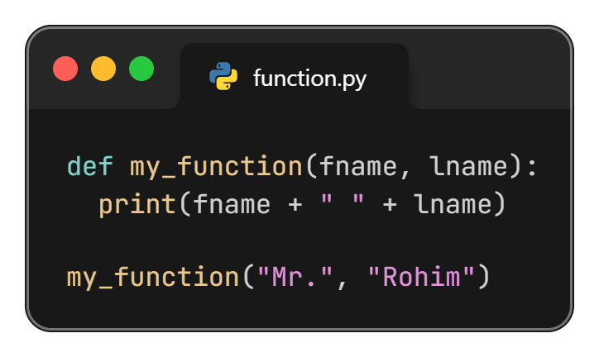
Number of Arguments
By default, a function must be called with the correct number of arguments. Meaning that if your function expects 2 arguments, you have to call the function with 2 arguments, not more, and not less.

Slide 14
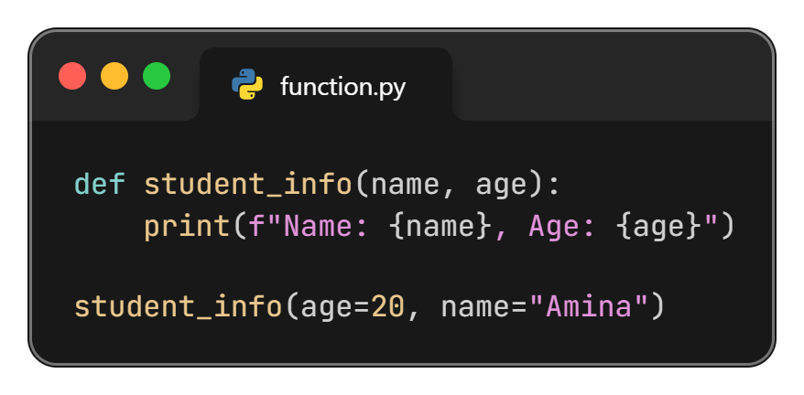
Python Keyword Arguments
In keyword arguments, arguments are assigned based on the name of the arguments.
You can also send arguments with the key = value syntax.
This way the order of the arguments does not matter.

Slide 15
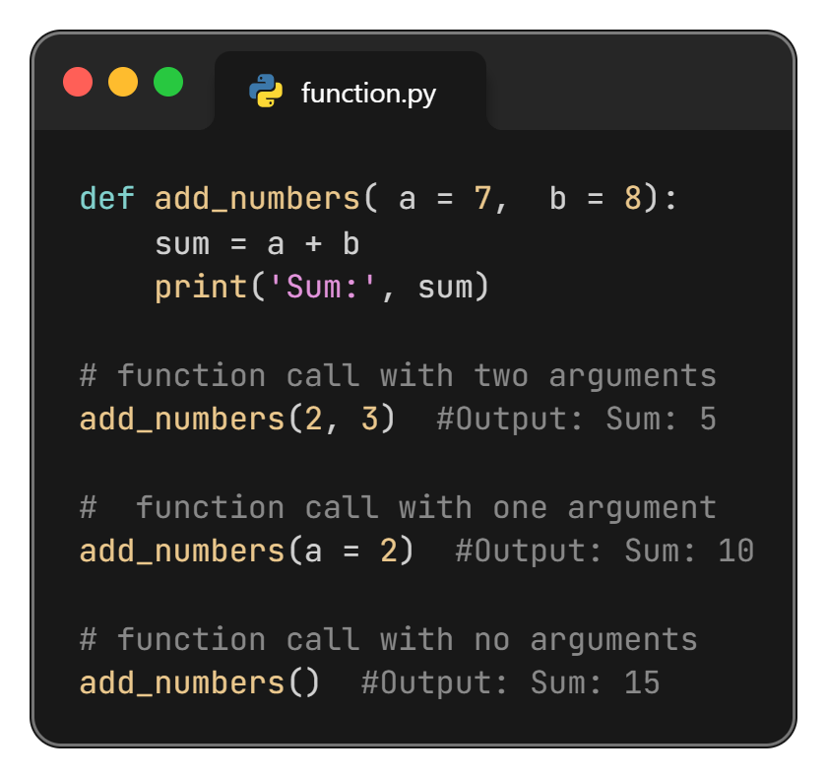
Function Argument with Default Values

Slide 16
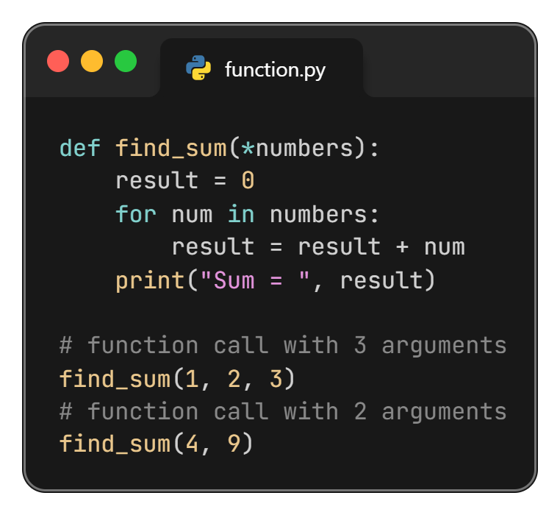
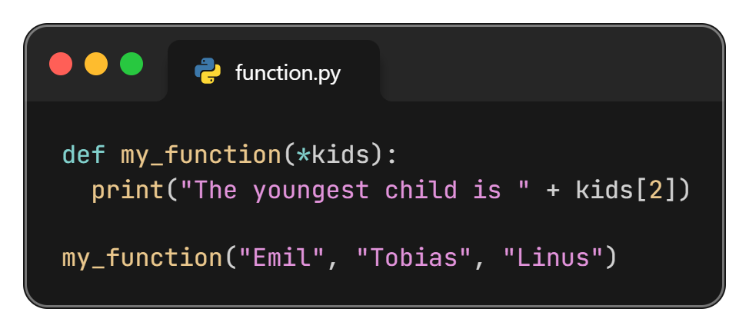
Arbitrary Arguments, *args
If you do not know how many arguments that will be passed into your function, add a * before the parameter name in the function definition.
This way the function will receive a tuple of arguments, and can access the items accordingly:

Slide 17
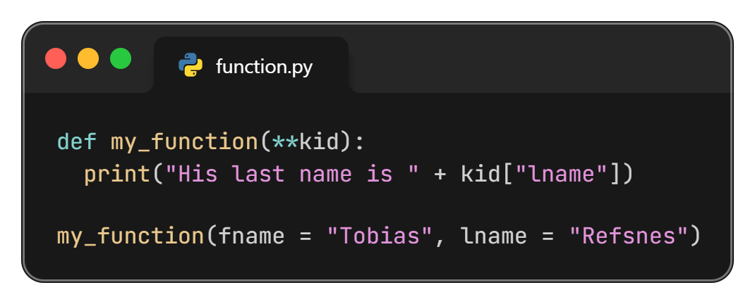
Arbitrary Keyword Arguments, **kwargs
If you do not know how many keyword arguments that will be passed into your function, add two asterisk: ** before the parameter name in the function definition.
This way the function will receive a dictionary of arguments, and can access the items accordingly:

Slide 18
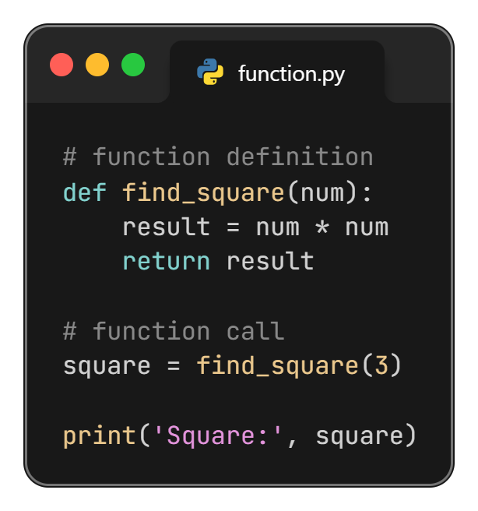
The return Statement
We return a value from the function using the return statement.

Slide 19
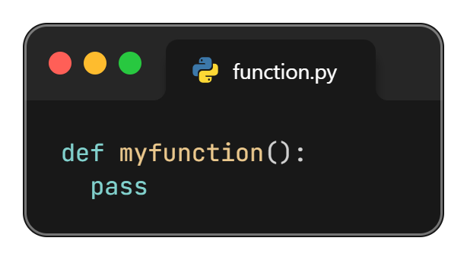
The pass Statement
The pass statement serves as a placeholder for future code, preventing errors from empty code blocks.
It's typically used where code is planned but has yet to be written.

Slide 20
Thanks All

